Slide 1
‘We can do anything together’
A case study in inclusion across two sites – Adelaide West Special Education Centre and Ocean View College
1st May 2014
Presentation to ACEL/ASEPA Congress
Lorna Fenech, Deputy Principal,
Adelaide West Special Education Centre

Slide 2
‘Our sites have a beautiful relationship based on the premise...."We can do anything together". This
attitude formed naturally and blossomed into a culture.’
Notes:
I renamed my presentation because of this wonderful statement that was put onto one of the staff surveys that was completed for me when I was looking at views about the ongoing relationship between Adelaide West Special Education Centre and the school on the same block, Ocean View College (OVC).
This video may not appear unusual at all in the first instance – two children on a trampoline and indeed this is a common occurrence in the school yard. However, the fact that each of these students is from a different school, one a mainstream school and one a special school that historically caters for students with complex communication needs and significant disabilities, makes it a great opener for my presentation.

Slide 3
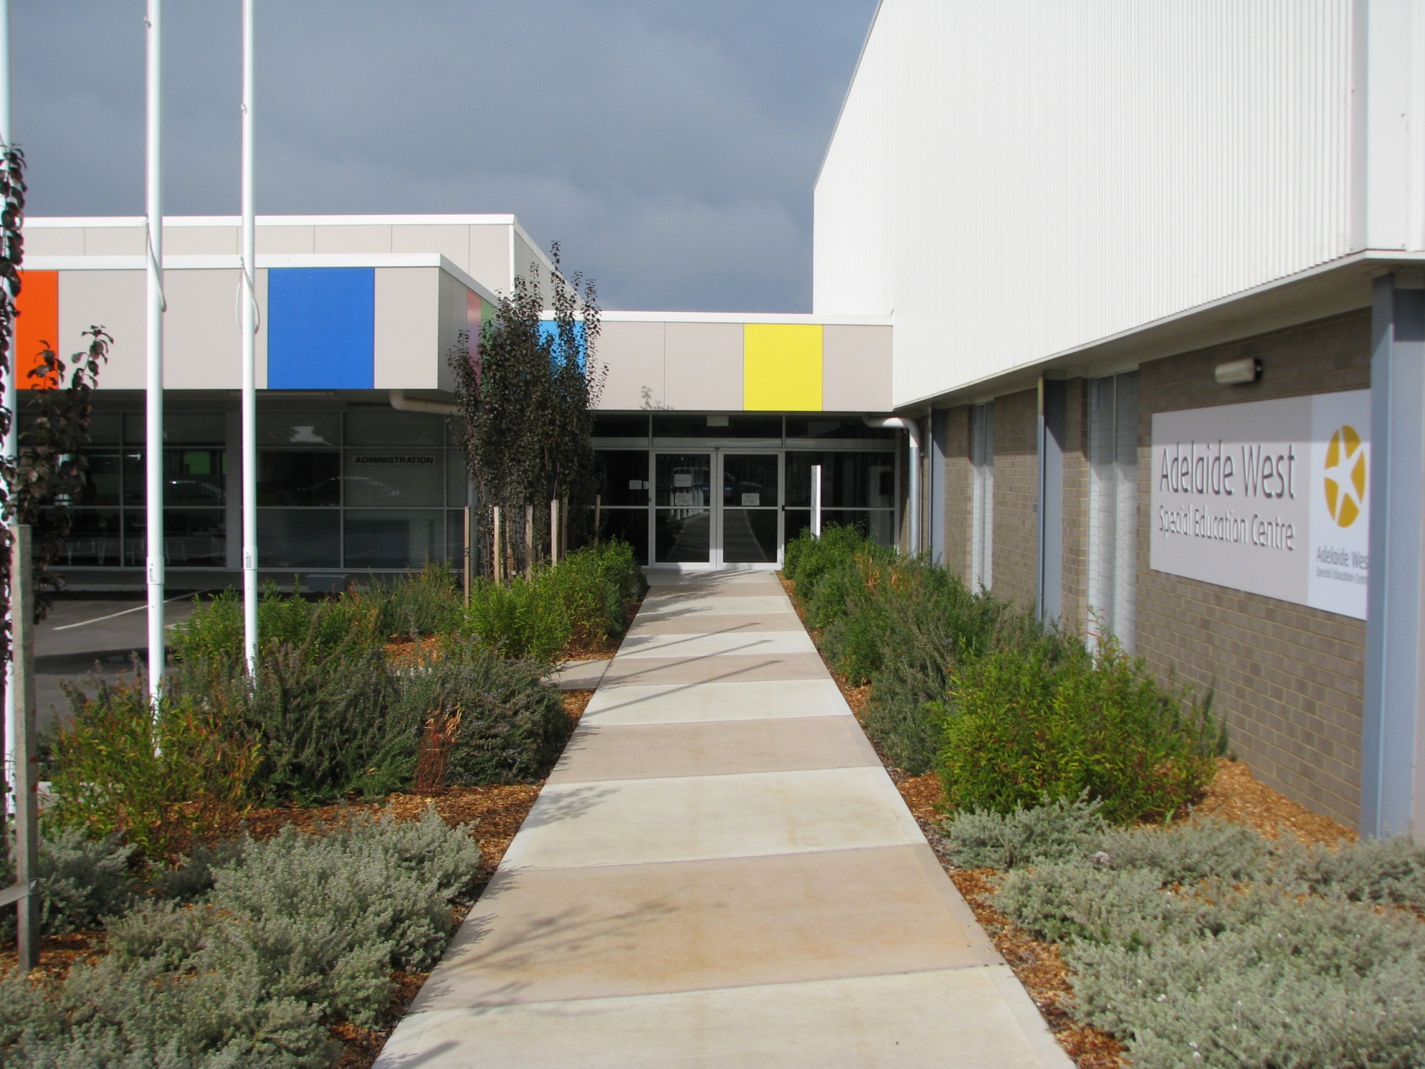
Context – Adwest pic
Notes:
Adelaide West Special Education Centre has been on its current site since 2010. Prior to that the school was located in a stand alone site alongside the non-government agency that provides our physiotherapy, Occupational therapy and speech therapy. When the Department for Education and Children Services (now the Department for Education and Child Development) decided to relocate the school this site was chosen because it was on the same block as a birth – year 12 college.
Students at Adelaide West all have complex communication needs and most use AAC rather than verbal communication. 75-80% of the students use wheelchairs for transport, although we expect most of them to get out of their wheelchairs to practise physical skills when at school. 25% of the students are ‘nil by mouth’ and receive nutrition through gastrostomy feeds. Many of our children have fragile health conditions and the level of disability that many of them live with can be confronting for people who are not used to it.

Slide 4
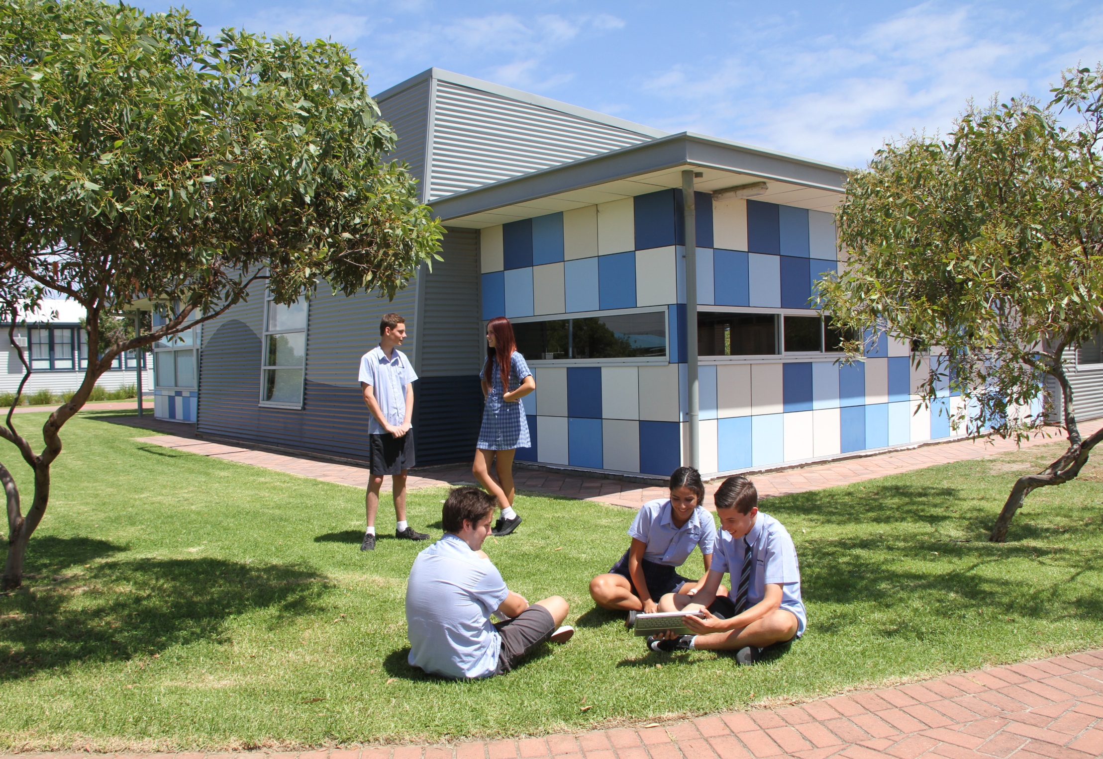
Context OVC pic
Notes:
Ocean View College B – 12 is a coeducational state government school. The college comprises a Children’s Centre, Junior School, Middle School, Senior School and Bridges Annexe. The staff and leadership team at Ocean View College have been welcoming of the Adelaide West Community ever since the move and have always been willing to consider or suggest new projects for the two sites to collaborate on.
This openness and willingness to work together has been crucial to the creation of a fabulous and deepening relationship between staff and students at the two schools.
I consider that the most important element in this has been the attitude of leadership at both sites. They all value the relationship and are willing to problem solve obstacles and challenges rather than seeing it as all too hard.

Slide 5
Picture of mural
Notes:
Picture of the unveling of the mural
Collaboration between the two schools began with one off projects such as the creation of the mural that now hangs in our foyer. A year 10 art class from Ocean View College worked with one of the Adelaide West senior classes to design this mural following community visits to Largs pier where they took photos that were then used to create the tactile mural.

Slide 6
Picture of Science Day
Notes:
Other special events that involve students from the two schools working together include Science Day, sports days etc

Slide 7
Pictures from Book week
Notes:
Book Week Parade picture and video of girl practising walking
The reception – year 5 students from both schools participated in a joint bookweek parade and parents from both sites came along to watch.
However, the most significant part of the collaboration between the two sites is the lunchtime Friendship Group when students from OVC come to the Adelaide West yard to play. This happens every lunchtime and has led to the development of friendships between students from the two sites.
From the point of view of staff as educators, this provides opportunities for students to practice skills that might be seen as work if adults asked them to do it but in the context of lunchtime Friendship Group it is fun and they will engage happily in it for far longer than they might with staff members.
One of the curriculum programs that we are accredited to run at Adelaide West is the MOVE (Movement Opportunities via Education) program in which students are supported to practise the skills of sitting standing walking and transition. Students from OVC are quick to understand the playground implication s of this and Adelaide West students are proud to practise their skills with their friends.

Slide 8
Feedback – staff from both sites
Anonymous survey to both sites
100% of respondents were aware of and liked the initiative a great deal.
‘I can remember the time when we found out Adelaide West was moving next door and never realised the amazing opportunities it would create for all our students! A match made in heaven!’
‘I feel we have a very good relationship
with the OVC staff’
Notes:
Recently I sought feedback from staff, parents and students who participate in the Friendship group. The feedback was generally extremely positive apart from one area that I will address later. All Surveys included many positive comments

Slide 9
Benefits seen by staff
Notes:
I used the staff feedback to create a Wordle which demonstrates the benefits beautifully!

Slide 10
Feedback – OVC parents
10 responses received
60% had children who had participated for 4/5 terms, 30% had only done 1 term.
When asked why their children had joined 80% indicated a wish to help
When asked about the good outcomes 60% mentioned friendships
Notes:
Parent feedback was also positive and reflected some anecdotal feedback that we have received from parents coming in for joint events such as book week and performances.

Slide 11
Comments from parent surveys:
‘This is a great experience’
‘Thank you for giving my child the opportunity to go over to Adelaide West she loves it’
‘I think the friendship group is an excellent initiative and an excellent way to develop a more understanding and accepting culture’
‘…its great to see the children/students interacting with each other the way they do.’

Slide 12
Feedback – students
All participants were positive
Half of the responses cited friendship something that was good, the other half mentioned helping.
When asked what was hard about it, one third mentioned death, one third mentioned communication difficulties.
All but one had previously known someone with a disability before joining the group.
Notes:
The feedback from students was interesting. I hope to be able to survey the students at OVC who don’t belong to the Friendship group to investigate ways to further extend what we are doing.
You will notice that some students mention death as one of the things that was hard about being part of Friendship group. WE had a very sad year at Adelaide West in 2013 during which we lost 4 enrolled students. This did cause some challenge for the students involved in the Friendship group

Slide 13
Challenges
Staff Feedback highlighted the following:
Time and coordination
OVC students will need ongoing awareness sessions and support in being a communication partner
Fragile health of some Adelaide West students
Mobility issues
Not enough of it!
Notes:
Staff highlighted a number of challenges to the extension and future development of the collaboration between the two sites but all felt it should continue.

Slide 14
Notes:
Video clip demonstrating how genuine the personal connection between two students is.

Slide 15
Only one comment in section in Parent survey on problems:
‘She gets sad when she hears something awful happens to them, when some of the poor kids die.’
Two students raised the issue;
‘Well just the part were you have a bond with a student then they pass and its really hard’
Strategies:
Involvement of DECD social worker
Memory books
Option to attend memorials
in Adelaide West grounds
Notes:
Parents and students raised the issue of students’ death as one of the challenges. As I said earlier last year was a shocking year for us. Although staff at Adelaide West understand that our cohort of students includes many with fragile health, dealing with a student death is always difficult and this was intensified for the students at OVC because they are not used to death so close to them in the community. This raised issues for us – we had to find strategies to assist them to come to terms with this in the same way that our students need to be supported to deal with the loss of a classmate. The DECD social worker is involved with both sites and we are working with her to try to improve our toolbox of strategies , always hoping it will be a long time before we need to use it again. We mark the death of a student by mounting a star with their name on it on one wall in our playground. Students from OVC can attend the ceremony when families come to school and a few words are said about the student. Books of what the student liked to do created by Adelaide West staff are also shared with OVC to help with the grieving process.

Slide 16
Possibilities for the future
More opportunities for interactions within class or setting up buddy classes – several staff highlighted this.
More structured planning opportunities
More chances for shared activities
Pathway joining sites
Notes:
As we look to the future we are hoping that more classroom based activities can begin to happen to extend the friendship of students into supporting learning in more academic areas such as literacy.

Slide 17
Interview Ashleigh and Chanelle
Interviewer: Do you think it makes a difference to the way your friends and other students think about students with disability coming over here?
Girl A: Yes I think it does because a lot of people think that kids with disability can’t really do anything and they can’t play but they really can.
Girl B: I really thinks so ‘cos the first time we came over we brought a lot of students with us but they were actually scared of the kids here but now they’ve got a really special bond together. We just all love them now.
Notes:
This extract from a video of two OVC students says a lot about the value of inclusion – I feel the rest of this presentation was just building up to this – they can speak for themselves!

Slide 18
Contact me:
Lorna Fenech
Deputy Principal
Adelaide West Special Education Centre
Tel: 08 8248 9100
Email lorna.fenech297@schools.sa.edu.au

